Slide 1
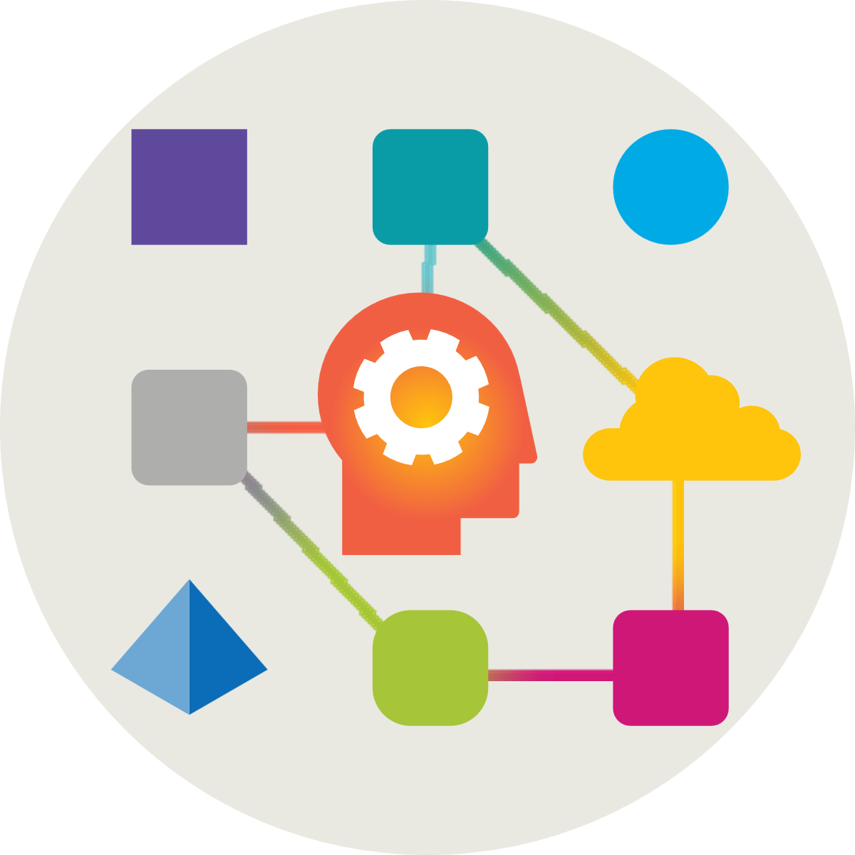
Launches
Cristina Saretti

Slide 2
Launch framework
Launch summary (Priorities/strategic objectives/potential blockers; who/what/when/where/why: develop themes)
Launch calendar (milestones and dependencies)
Product roadmap (what they have now, what will get shortly, where we are going longer term)
Content (product documentation, launch materials)
Internal comms (sales and partner enablement/ newsletters)
External comms (campaigns, PR, events, social, etc)
Customers and research (validation with clients, analysts, quotes, case studies. Industry verticalization)
Competitive intel ( market conditions and what our competitors are doing)
Tasks/schedule ( deliverables and due dates for each workstream)

Slide 3
Launch summary: Strategic Decisions and Dependencies
Topic | Issue | Impact | Comments
Launch Strategy - agreement to launch at Deliver 2022 | Uncertainty around numbers of clients in attendance at Deliver | Message at launch could only reach limited audience: develop supporting events strategy | Ensure we have a program of local events and online events to amplify the message via regional/local events, online events (recordings, LinkedIn live etc)
Thematic launch to tie in with communication of new joint value proposition |  | Reiterate highest level messaging Enable on next level down messaging

Slide 4
Timelines
Email to leadership cob Monday 8 Aug to let them know script is coming
Finalise high level messaging internally in Product Marketing by 11 Aug
Messaging in place for review by Leadership (Paul, Gautam - plus Danny and Jeff -- ask Steve who he thinks) – 12 Aug
Review finalised by 17 Aug
Word based script by 31 August
Format: Fireside Chat – investigate possibility of LinkedIn Live session
At very least get the session recorded and then use it as soon as possible afterwards as part of the campaign to drive more to IB
Do a webinar post Deliver which does a version of the Fireside chat, Then have additional sessions that spotlight one of the products
Content creation:
Slides will purely be to support fireside chat.
Videos 26 Sep
Enablement deck 16 Sep (Enablement sessions running w/c 19)
Incorporating this launch in to the existing Event campaign that’s being run and making this a feature
Product specific BOM items (PPT, webpage, data sheet, video, demo) for each 30 Sep
PR
.com page
Drop dead date for Product Management 12 Sep
Map the experience – how this session works and then how the messages roll out to the other sessions and in the Kiosk
Could do some outreach leveraging the assets we have in September e.g. JVP ebook, followed by video, followed by infographic for example. Then post Deliver market the hell out of the post Deliver webinar and then the series of product spotlights.

Slide 5


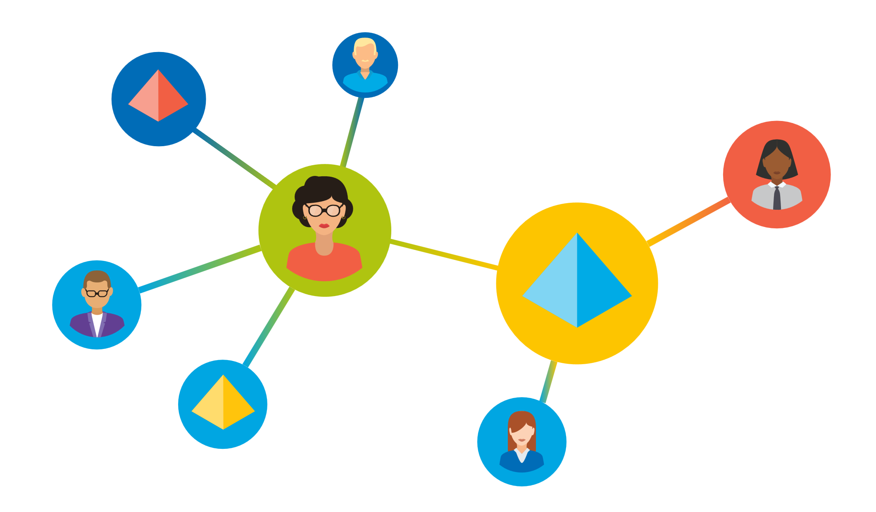


SS&C | Blue Prism® Helps You Deliver Transformational Business Value
ATB as potential customer to support the messaging – on site (fireside chat)
VM02 can provide some video footage to support this too (video content to add to session)
Potentially a partner too who is sponsoring the event. EY have not confirmed sponsorship – Latitude, Wonderbots, Invoke
Unify the Workforce
Transform Journeys
Scale Enterprise-Wide
Operations
Processes
Tasks
HL = PR headline
Connect people and digital workers
Re-engineer for customers and employees
Implement and orchestrate across the business
(HL) BP : Chorus Integration – GA date now
(HL) UX Builder – GA now
(HL) Director: Priority and SLA Scheduling – GA end Nov – – is this date achievable?
MINOR: Capture: Solution Designer – better collaboration e.g. business user with designer – GA end Nov – is this GA date achievable?
Capture: Solution Designer (plus Process Intelligence integration) – GA end Nov – is this GA date achievable?
AISA – GA date now
(HL) ROM – GA date September
(HL) Email AI: Realtime Feedback Model Training (also highlight Decision for e.g. REFUND) – GA Oct for v5.0
BPC on AWS – GA date pending due to O365 issue currently being investigated
Notes:
Purpose:
Highlights exactly what SS&C Blue Prism provides to enable our customers to deliver transformational business value
This is, essentially, the joint value prop
Key Messages:
Unifying the workforce into one collaborative workforce by seamlessly connecting people and digital workers to deliver the right outcomes for the business
Transforming journeys (workflows) the way work courses through the business and its customers by connecting work that happens at all levels – and in so doing reengineering customer, employee and user journeys alike
Elevating the focus to scale Enterprise wide by providing visibility, orchestration, and control across the entire enterprise with operational dashboards and workforce management
And it’s the combination of all three that will help companies realize the true potential on IA
Full Talk Track:
Firstly, we help organizations unify their workforce …
…By connecting the entire workforce, both people and digital workers, into one collaborative workforce that operates seamlessly together to achieve the right outcomes for the business.
We do this by ensuring work is done by the best resource for the job. For example, leveraging digital workers to undertake routine, transactional activities such as digesting data, making updates, tracking progress and more. Whilst enabling people to undertake higher value, more complex work such as the human touch, relationship management, conflict resolution and problem solving.
We call this an automation-first mindset - Automating work wherever you can and using people wherever you should. Striking a balance between the human heart and the intelligent brain
But we also do this by empowering the workforce, both people and digital workers, with the latest AI and machine learning technology to help them do their jobs even better than before and expanding the relative output and value of them.
This is where Blue Prism, in particular, has been incredibly powerful in the past.
Examples :
Sophisticated capabilities that enable human in the loop processing, where part of the task or process can be done by the digital workforce but when an exception or a deviation occurs or indeed a different type of skill set is required, a human worker can be brought in to move the workflow to the next stage upon which it can be handed back to a digital worker for further processing.
Responsible automation on the desktop - enabling organisations to automate frequently run tasks that need to be undertaken by people and run on a specific user’s desktop. But doing this in a way that ensures the governance, security and auditability requirements are adhered to because, although they’re triggered and run locally on the user’s desktop, the automations are developed and validated centrally by IT.
2. Secondly, we help organizations transform their customer, employee and user journeys…
…Allowing companies to rethink how work is done and reengineer journeys for better customer and employee experience
We do this by elevating and connecting work at every level of the organization. Connecting individual tasks, into end-to-end processes, and across entire business operations, Making sure each journey is supported with exactly what is needed when it’s needed irrespective of what work needs to be done, at what level in the business the work happens, or which resources are best suited to deliver it.
This is where both Chorus and Blue Prism, have been incredibly powerful in the past.
Examples :
Case management – being able to bring all the individual talks together and string them together into the end-to-end journey, from when the initial case is opened all the way through all the tasks, processes, functions and work involved to close the case.
Process mining to understand what is really happening in the business including all the bottlenecks and deviations and use this to redesign the process and simulate the improvements which is then reflected back into the business process management applications to run and manage that new, reengineered process.
3.Thirdly we help organizations scale their intelligent automation efforts across the entire Enterprise…
…Providing the visibility, orchestration and control, across the whole business to manage the entire workforce and end to end journeys.
We do this by providing organizations with a single view of all their functions, processes, and resources in real-time, together with a comprehensive toolkit to manage and control the work across the organizations; Things like streamlining and optimizing processes, expanding and contracting staffing as workloads fluctuate, or integrating AI to support complex processing .
And all of this is underpinned with the Enterprise grade resilience, scalability, security and governance that organizations have come to depend on us for.
This is where Chorus, in particular, has been incredibly powerful in the past.
Examples :
Operational dashboards and management interface which show what work is happening, who is undertaking it, how well it’s performing. Providing the ability to continuously monitor processes in production with a 360-degree view across the digital and human workforce, the systems they’re using, and the processes being run.
Workforce management – enabling organizations to look across all the people that you manage today, utilizing capacity planning / outcome planning, being able to monitor what applications potentially those users are currently in, and then manage the people inside those processes.
BPM – supporting workflow, orchestration and work assignment enable managers to assign the right capabilities (regardless of digital vs human) to the needs of the work to be done

Slide 6
UNIFY the Workforce
The right resource, every time, for the best outcome
Connect people and digital co-workers
Use people wherever you SHOULD
Automate wherever you CAN
Balancing roles in the execution of work
Natural language
Routine tasks
Empathy
Relationship management
Analysis
Problem solving
Predictions & what-if
One team working together
Exceptions
Decision making
6
Notes:
Purpose
To provide more detail into what unifying the workforce really means
Key messages
Full talk track
Connecting people and digital workers to create a single team collaborating and seamlessly working together. Today, this will, for most businesses be confined to resources within the organization. In the future this could extend to resources outside the organization.
Balancing roles to ensure that the business has the right resource, with the right skill set, every time, for the best outcome for the business
Using people wherever you SHOULD (e.g customer facing roles, roles that need creative thinking, relationship mgmt. etc) and Automate wherever you CAN (e.g repetitive, routine tasks, analysis etc)
But this is changing as we are seeing digital workers do more sophisticated and complex work such as natural language engagement with a customer or complex decision making
The point is that its one workforce and digital workers are not working alone in silos
These roles are not fixed and can flex depending on the needs of the business

Slide 7
Transform Journeys
Focused on business outcomes
Connect and enable work at every step and level
Eliminate functional silos
Align all work to outcomes
Reuse best practices and procedures
1 Journey
Operations
Multiple Processes
Processes
Rethink work…Deliver exceptional experiences
1000s Tasks
Tasks
Notes:
Purpose:
To provide more detail into what transform journeys really means
Key messages:
Full talk track
Transforming journeys is about elevating and connecting work at every level of the organization. Connecting individual tasks, into end-to-end processes, and across entire business operations
Our solutions allow companies to rethink the way work is done ensuring that all tasks, processes and journeys are aligned to a specific business outcome irrespective of whether that work is being carried out by people or digital workers
Instead of managing 1000s of individual tasks and multiple processes, companies are now able to focus on the whole end-to end journey building better, customer, employee and user experiences.
Each journey is supported with exactly what is needed when it’s needed irrespective of what work needs to be done, at what level in the business the work happens, or which resources are best suited to deliver it.
This eliminates functional silos we have seen in many organizations and promotes the use of best practice and procedures across the whole business
This is where both Chorus and Blue Prism, have been incredibly powerful in the past.

Slide 8
UNIFY the Workforce
What are the realities workforce of today
great resignation / siloed functions / lack of alignment etc
Need to find a better way to get work done
What does the future workforce look like?
One team working together
DW becoming cleverer so can do more, People expect EX – time and capacity to work more fulfilling lives (So there is no EXCUSE not to be able to accommodate both)
This is about people and digital co-workers connected together
No silos; seamless collaboration and balanced work; automatic orchestration (just happens);
Balancing roles in the execution of work
How does management neeed to change to support a world of people / DW workforce
Why does a unified workforce result in?
The right balance that ensures the right resource, every time, for the best outcome
Delivers the best results for everyone (the employee, the business, the customers)
Focused on business needs and goals (biggest impact and best results)
What is coming down the line soon to further expand on this?
Build better collaboration across your human workforce too and support them with technology that enables them to work better together - MINOR: Capture: Solution Designer – better collaboration e.g. business user with designer
Key Areas to Explore as Part of Launch
‘Wastage’ is not acceptable (ESG)
BP : Chorus Integration – GA date now
Include operational analytics
MINOR: Capture: Solution Designer – better collaboration e.g. business user with designer

Slide 9
Transform Journeys
Fausto
Delivering great customer experience and employee satisfaction is on every company’s agenda. Not surprisingly as both have a major impact on the bottom line as well as helping to drive other business goals. What are the issues that companies are having to fix?
Firstly the events of the last two years has had a profound impact on people. Organizations have had to quickly reinvent the way people work. That meant creating the right technology experiences, creating a more frictionless, collaborative work environment as well building the right culture and ensuring workers felt cared for during a difficult time. Customer expectations also changed, becoming more demanding, wanting greater flexibility, convenience, faster interactions.
As a result companies have had to review existing practices, fix fundament problems with processes, inefficiencies, how customers are handled, how work is performed etc. As an example in CC of manually trying to pull all this together, lots of info all over the place, trying to get single view of customer
Companies know that in order to fix this properly, it needs to be tackled enterprise wide. But This has been hampered with lack of resources, time, data and insight on what to fix. The focus has been on getting quick wins, often at a task level, in separate departments without visibility end to end.
But that’s so important. Right. Focusing on the whole journey end-to-end can deliver huge benefits?
Firstly it delivers a seamless digital experience for customers, employees and users of course. It also allows you to align all your resources making sure everything is pulling in the same direction to deliver great experiences and most importantly better business outcomes.
A great employee experience gives employees a sense of belonging and inclusion, a sense of purpose and the satisfaction of doing purposeful work. This can lead to increased talent acquisition and retention. This is especially critical as competition increases for an increasingly limited talent pool.
And of course, having happy employees leads to happier customers
Absolutely it promotes a positive service culture, making it a better, more productive environment for all. In fact in a recent IDC survey for example, 85% of respondents agree that an improved employee experience and higher employee engagement translates to a better customer experience, higher customer satisfaction, and higher revenues for their organization.
What about benefits for the business
For the business it mean being able to be more agile and flexible reacting quickly to changing business needs as well changing customer demands.
Companies are also able to streamline and optimize processes, continuously innovating and making whatever improvements are required to deliver against business expectations
It also helps companies to drive a better esg agenda, removing inefficiencies, reducing wastage etc.
So what does Transforming a Journey look like?
Its about rethinking the way work is done, connecting and enabling work at every step and every level. Supporting every journey with what is needed when its needed. Making sure any functional silos are eliminated along the way and reusing best practices and procedures
Its also about giving more control back to employees and business units. IT will take you some of the way but its not until you involve those on the ground experiencing the day to day issues, you get major improvements.
Ultimately Its about delivering exceptional experiences for customers, employees and users
What examples can you share with us
Making it easier for businesses to transform journeys is key to us at SS&C Blue Prism to ensure companies realize the true benefits of intelligent automation and there are a couple of new developments I would like to tell you about.
Firstly we have added new features to support both the business user and process developer, making the collaboration between the two more streamlined. We’re giving them the tools which provide the insights to make an informed decision as to whether to make the improvement / optimization or just automate the existing process. This will ensure journeys are full optimized to deliver the best results.
We have also given business users who are closest to the customers etc. greater capabilities to automate and transform journeys with our easy to use no-code development tool. It gives control back to the business (they know the processes best), and do this 10x faster because it accelerates time to value (easy, not waiting for scarce resources, prebuilt components / reusable, etc. And of course we do this the right security and governance in place.
Email AI:
Don’t spend time managing inboxes and getting overwhelmed with unnecessary work
Get the right resource doing the work when it comes in and don’t leave customers waiting
Which could be handing over to a DW, leveraging AI/ML decision making to process further, popping into a workflow within BPM for a person to review as part of a case, etc. (also highlight Decision for e.g. REFUND)
Key Areas to Explore as Part of Launch
UX Builder – GA now
Capture: Solution Designer (plus Process Intelligence integration) – GA end Nov – is this GA date achievable?
Email AI: Realtime Feedback Model Training (also highlight Decision for e.g. REFUND)

Slide 10
Scale Enterprise-wide
Junaid
What are some of the issues experienced today?
Initial scope was very limited (think big from the start)
Low confidence in ability to scale
Difficulty in adapting to change quickly
Little to no alignment between the business and IT
Lack the resource/infrastructure/support to scale and manage solutions
Unable to manage the cultural shift / overcome ‘we’ve always done it this way’
Elongated time to value
Lack of visibility / control on how the processes and automations are performing
Manual effort to manage workforce to ensure the full benefit / value / results are being delivered .
Poor insights end to end – make a change in one place with no idea how it impacts somewhere else
Compliance and governance
Why does it need to be transformed?
Alignment across the business – all pulling in the same direction
To be able to change / adapt / respond to business needs
Demonstrate ROI on what is being done
To gain maximum benefit, you need to manage / control / orchestrate end-to-end
To enhance CX/EX across the board (not just in pockets) and the associated outcomes e.g. growth, revenue etc.
What does Enterprise-wide scale look like?
The ability to monitor and orchestrate work end to end – right work for the right resource
Be able to predict future demand based on historic trends and assign work accordingly
Manage so issues are identified and addressed before they become problems / Agile business – knowing what’s happening and then being able to pull the levers to make the changes you need
Best practices (blueprints to do it right every time) and continuous improvement
Expanding the number of people who can do it / reduce IT bottlenecks and do this 10x faster because it accelerates time to value (easy, not waiting for scarce resources, prebuilt components / reusable, etc.
What is coming down the line soon to further expand on this?
Director – removes the need for manually scheduling all work (across all the work queues) by using AI so the most important priorities are completed first
BP-Chorus integration – greater visibility which helps with reduced effort and enhanced UX to deliver a faster turnaround and accelerated time to value. Single vendor, single platform – simplifies management and enables integration / interoperability across all the parts, reduces TCO overall
ROM (revised) – to do this at higher scale with all the governance required
Cloud: If you want to do this enterprise-wide, the best way you can do that at speed, and focused on your business (without the hassle of managing the underlying technology), is with cloud. Any choice of cloud vendor
Key Areas to Explore as Part of Launch
Director: Priority and SLA Scheduling – GA end Nov
AISA – Q4 now
ROM – GA date September
BPC on AWS – GA date pending due to O365 issue currently being investigated

Slide 11
Capture Solution Designer TRANSFORM JOURNEYS
What does it do?
This new mode will make it easier for business users and process analysts to optimize a process through its free-form, drag-and-drop UI. Processes are split into zones so the user can instantly see where improvements can be made.
Why is it significant?
Many organizations automate sub-optimal processes as they go from the as-is straight to automation. Solution designer will guide users to optimize before they automate to maximize the productivity and efficiency gains they could realize from automating the process.
Who is it aimed at?
Process owner – this is the business user that was doing the original process. Solution designer is a no-code tool so the business user can play an active role in helping optimize the process as they have the knowledge that the analyst/developer does not. Process analyst – this person is required to work with the process owner to define and optimize the process. Solution designer helps them as they now have a far easier method for process optimization within Capture itself – making collaboration between the two far smoother as they're using a single, no-code tool.
How is it different?
Capture will become the only tool on the market that includes definition (PDD), optimization (solution designer) and solution design (automation prototype) in a single tool.
Tom Chiles (Product Mgt)
Junaid Zahid (Product Marketing)

Slide 12
Process Intelligence Integration with Capture TRANSFORM JOURNEYS
What does it do?
Functionality in a nutshell
Why is it significant?
What is the value it delivers? How does it bring transformational business value?
Who is it aimed at?
Different levels of messaging: think of the target audience and how it ties into the value prop. Does the theme that we develop from all these releases tie into the highest-level value prop or the next level down?
How is it different?
From what our they had before, from what our competitors offer
James Wood (Product Mgt)
Claudia Andahl (Product Marketing)

Slide 13
Email AI Realtime Feedback Model Training UNIFY THE WORKFORCE
What does it do?
AI-based email classifier and extractor available as an API; plug the API into your existing BPM or RPA processes or other systems; enable straight-through processing for high-confidence predictions; routs low-confidence predictions to people to handle and train the AI model. 6-week turnaround for training from the date we receive the data.
Why is it significant?
What is the value it delivers? How does it bring transformational business value?
Saving hours extracting information, classifying it and typing it into a form. Helps deliver more immediate responses. Enables human workers to focus on higher-value tasks. Not just about saving time, bigger impact is that you are responding immediately (increased straight-through processing), no delay in the process, quicker customer response. Feeds into Blue Prism Decision.
Who is it aimed at?
Chorus/ Blue Prism customers that can consume a REST API and are able to provide us with an email body and subject line. For BP customers, now your DW can take the information that has been extracted from the email and perform the actual transaction associated with the request. If it’s a Chorus customer, the information gets transferred to your BPM, a case is opened in the correct workflow and you can start managing your work immediately. Target customers: companies that receive 800-1000 emails a month. Industries: out of the box ready for retirement industry (SRAs, payroll and transaction processing). Will expand to other industries in subsequent versions.
How is it different?
From what our they had before, from what our competitors offer
Difference between us and Re:infer: the Re:Infer product is point/click/train: involves pointing cursor to something, manually clicking on a word or series of words and training the algorithm to retrieve the info. Our model instead is pre-trained, we have “labelled data” which categorizes the information in advance without the need for the business user to get involved and do this manually.
Kavitha Chennupati (Product Mgt)
Greg Walker (Product Marketing)

Slide 14
Document Automation Pre-configured Industry Forms ACCELERATE WORK
What does it do?
We have created an automated process through which the client selects the form from which they would like to extract data and it’s instantly loaded into their account, therefore eliminating the need for set up
Why is it significant?
Reduce upfront processing time, reduce implementation lifecycle and the cost of this implementation does not fluctuate.
Who is it aimed at?
Currently available: pre-configured forms for the health insurance industry. Target audience is LOB super user. From a company perspective: 50% current customers, 50% prospects. Good door-opener
How is it different?
From competitors: ease of use and ease of set up. Even if our competitors say it’s “plug and play” there is still a significant amount of training required even for these pre-configured forms
Stephanie Neveu (Product Mgt)
Greg Walker (Product Marketing)

Slide 15
UX Builder Build mobile experiences TRANSFORM JOURNEYS
What does it do?
New low code/no code app development feature of Chorus aimed at business users: they can build a web application using a simple drag and drop functionality. It segregates design from all the complex technical aspects. In the 5.0 release (Oct timeframe) it will be possible to invoke a BP digital worker directly from UX builder (“fire and forget”)
Why is it significant?
Relieves reliance on developers/IT.
Who is it aimed at?
Business users, implementation consultants, anyone who knows the business use of the app they want to build but don’t have the technical skill to write code for it. All industries but most like to be used in finance and healthcare.
At the moment: must have Chorus user ID and password (Chorus is a gateway to access UX builder). It would require a bit of development work to make this available as a separate offering to BP customers (Ie that they get authenticated via their BP user ID and password) that don’t have access to Chorus. UX builder is cloud-based, available to managed-hosted clients.
How is it different?
Ease of use, simple drag and drop functionality
Clara Raj (Product Mgt)
Greg Walker (Product Marketing)

Slide 16
Director Priority and SLA Scheduling SCALE ENTERPRISE-WIDE
What does it do?
Configure interact forms to allow for priority and SLA parameters; add business importance weightings, view insights on whether work has been completed within defined SLAs
Why is it significant?
Removes the need to manually schedule digital workers, making scheduling more efficient.
Moves us into the orchestration space
Who is it aimed at?
Existing customers with 50+ digital works and 10+ processes
How is it different?
From what we previously offered/ how is it different from competition? What makes it unique?
Our 20 years of experience enable us to provide our customers with a single source for their automation needs
Tom Blackburn (Product Mgt)
Junaid Zahid (Product Marketing)

Slide 17
BPC on AWS Additional option for delivery SCALE ENTERPRISE-WIDE
What does it do?
Functionality in a nutshell
Why is it significant?
What is the value it delivers? How does it bring transformational business value?
Who is it aimed at?
Different levels of messaging: think of the target audience and how it ties into the value prop. Does the theme that we develop from all these releases tie into the highest-level value prop or the next level down?
How is it different?
From what our they had before, from what our competitors offer
Matt Tarnawsky (Product Mgt)
Patty Yan (Product Marketing)

Slide 18
Deliver Sessions
TITLE
Realizing the Promise of Digital Transformation with Intelligent Automation
ABSTRACT:
It wasn’t long ago that the ambitions of firms implementing intelligent automation exceeded the capabilities of available technology. Fast forward to 2022, where intelligent automation is one of the fastest growing software categories. R&D, M&As and startup innovation in intelligent automation are providing organizations the opportunity to deliver on their business transformation initiatives like never before.
In this session, learn about the latest innovations from SS&C Blue Prism to help you realize the power of transformation with intelligent automation.
1 speaker: Gautam
1 customer, ATB Financial, Ray MacDonald - to validate and expand on what Gautam is saying
1 moderator: Natalie
Tuesday 4th October 2022
10:25-11:10 am

